Slide 1

Xenesis: Library Management System

Slide 2
Acknowledgement
We are thankful to our college “ Shri Vaishnav Vidhyapeeth Vishwavidyalaya” and our instructor Mr./ “ Gurpreet Singh” for providing us an opportunity to make a software project and giving us all support and guidance which made us complete the project duly, and the knowledge we inherited by our classes with IBM and in making of this project.
I am thankful to and fortunate enough to get constant encouragement, support and guidance from all Teaching staffs of [CS and IT ] which helped us in successfully completing our project work. Also, I would like to extend our sincere esteems to all staff in laboratory for their timely support.
And last but not the least we would like to thank our Parents, class mates, and to all who contributed to this project.
Sincerely,
Team Xenesis

Slide 3

IBM Major Project
Xenesis Team Leader :Suryansh Trivedi
Xenesis Team Members :-
Utkarsh Gumphekar.
Sankalp Patel.
Rajat Gour.
Raghav Partani.
Shivansh Pratap.
Umair Qureshi.
Ritvik Dubey.
Team Xenesis:
Xenesis.lib@gmail.com

Slide 4
Introduction
SVVV, Indore is a renowned university of Indore . SVVV is trying to expand their Library and would like to provide an automated library management system. One of the most important part of an institution is library management . Students are provided with the facility of making their E-lib Id ,And the administrator will also be provided the ease of managing the student data available and edit it , Administrator will also be able to manage all the data of books.
In our software Xenesis there will be a separate database for books issue and the penalty of late submission etc. Currently, the student have to visit the Library physically to issue a book . While doing so a great time is wasted in finding books in racks , check the avaibility of books etc. of time in application, Xenesis:Library charges payment, complaint registration -etc. Some of the customers have also questioned the transparency of Xenesis:Library allocation. To maintain the trust and reduce the Xenesis:Library Service cycle time, the library has decided to add the service of Xenesis:Library application, Complaint registration and Xenesis:Library charges payment on their web portal.
The Library Management System should be used by the students and librarians to manage the library by software automation.

Slide 5
Technologies used
QT framework.
SQL (php my Admin)
Apache server
SMTP server – auto mail
QR scanner
HTML,CSS,PHP
Autorun(windows batch programming)
Further technologies:-
Hashing algorithms and Salting for password sequence.

Slide 6
Introduction to QT framework
Pronounce as “cute” or QT.
QT is an open source software.
Cross platform application development framework.
User experience across hardware platforms.
It goes beyond GUI (database access, xml parser, web,….)
It can bind to any language and can be written in C++, python, C#, Ruby, Ada, Pascal, PHP,Perl,
and Java.
It is high quality, mature, free, excellent support for localisation, support 32/64 bit computing.
It contains rich set of widgets(1000+) , Qwt(25+) classes.
Very good documentation, help, and examples.

Slide 7
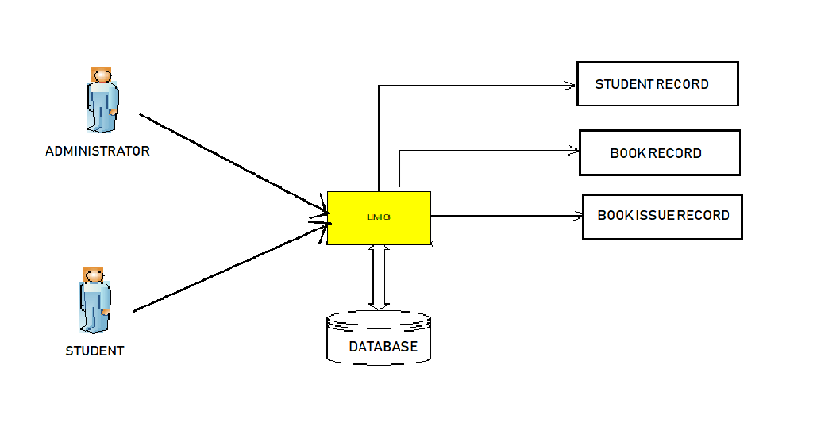
System context diagram

Slide 8
The diagram above explains the main conceptual elements in the solution and their relationships with our library management software. The Xenesis: Library Management System ( XLMS ) will have the data of the students who have made their accounts on our software and also can make new account. Library management system will have to manage the request from students and administrator also at the same time. Authorized Administrators/Librarians will maintain Library details through the system which in turn will be accessed by the students through their E-lib cards. The interface with the existing Student Account and data of books, books issuing Management will be fully shared with the administrator for Xenesis: Library management and Management related to the penalties.

Slide 9
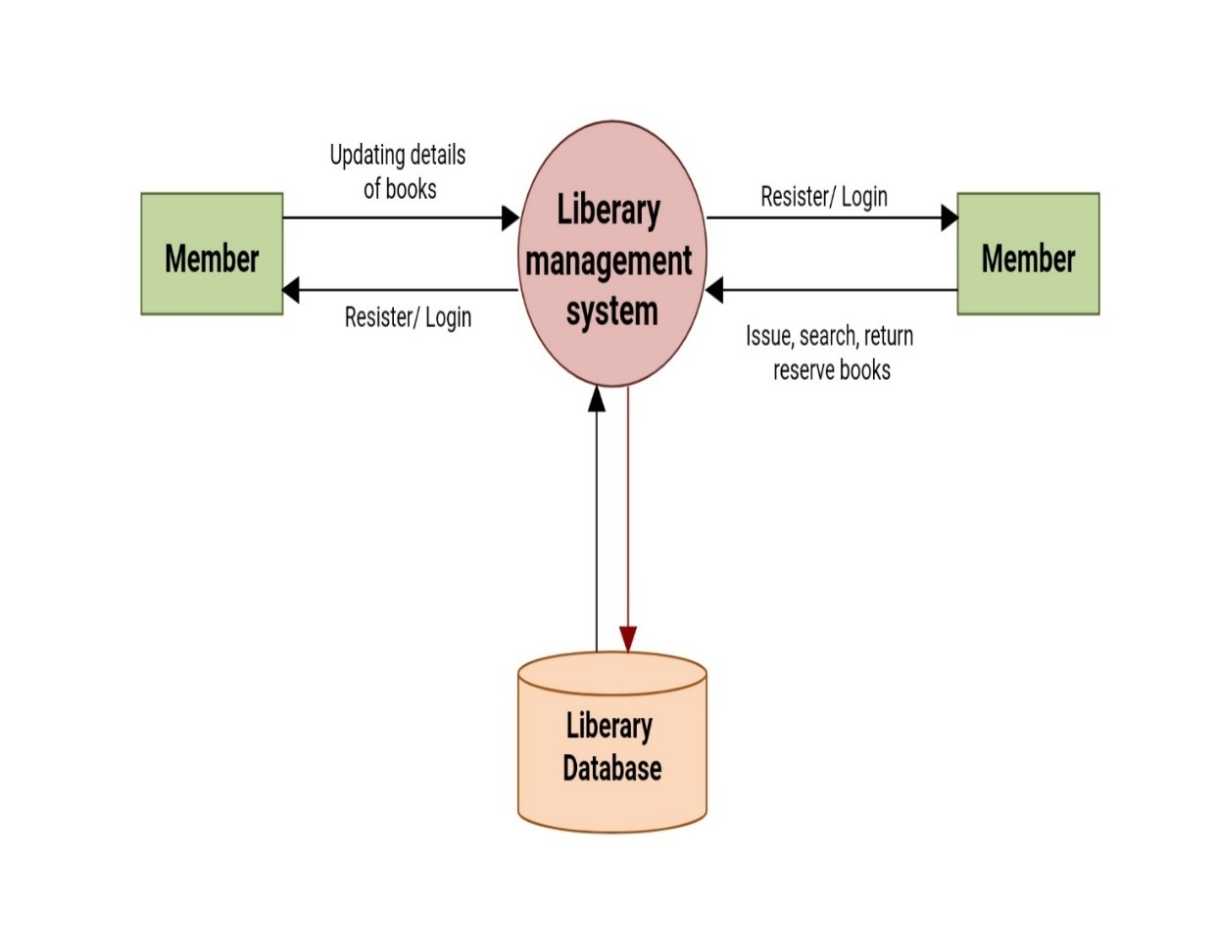
Use case diagram

Slide 10
The high level functional requirement for the Xenesis: Library Management System ( XLMS ) for SVVV is represented in the Use Case diagram shown above.
Following are the identified functional requirements of the XLMS System
Provide role based access to the system (Student and Administrator)
Librarian / Administrator – To Login and maintain Xenesis: Library details. To approve Xenesis: Library requests, discontinuation requests, get various analytical reports and add new contents in software and in physical.
Registered Student – To Login and get knowledge about all books status in library and manage E-lib card for book issuing.

Slide 11
The diagram above explains the main conceptual elements in the Library Management System. The Xenesis Library Management System ( XLMS ) component interacts with the Students, books management system and Administrator. These systems receives requests from librarian and students . Librarian will maintain library details through the administrator which in turn will be accessed by the students

Slide 12
Objective
The purpose of the project is to maintain the details of books and library members of different branches. The main purpose of this project is to maintain a easy circulation system between students and the libraries, to issue books using single library card, also to develop a software to which helps issuing and deposit a book through student login and update the book database from administrator login with some administrator feature comes with our Xenesis library management system(XLMS) and to maintain details about the user (fine, address, phone number).Moreover, the user can check all these features from their home.

Slide 13
scope
This document describes the scope of the requirements for the Library Management System ( LMS ) for SVVV. The document details all the high level requirements with intent to validate SVVV requirements. This document should be used by the student to design the Library Management project. In addition to this, the document also describes the broad scope of the project. The scope of the project involves the integration of a subset of all the components of current IT environment. The Library Management System ( LMS ) should interface with the Librarians and students.
The system must maintain central data for effective library management, Student login, student signup, administrator login, administrator signup. The system should process the online student’s request for book issuing, Xenesis: Library will also contain the book availability data, book returning date. The database will also contain the reference book of each subjects. The administrator privileges will contain the access to all the student’s data and would be able to manage all the student record like payments, renewing E-lib card and also generate various reports about the books. There is also the need to have an interface for students where they can view all the details about their E-lib id and also see the book availability anywhere. The system must maintain all details about Library allocation transaction of penalty of the student. The scope of the project also involves the development of the interfaces with the existing one which is totally manual working type to the semi/automated library management system, which will contain all the student record about their book issuing, availability of books, E-lib card which can be used for one book issuing detail, book returning details. Account system that validates the student and librarians/administrator helps in easy communication between operator the system and thus ease of management in Library.

Slide 14
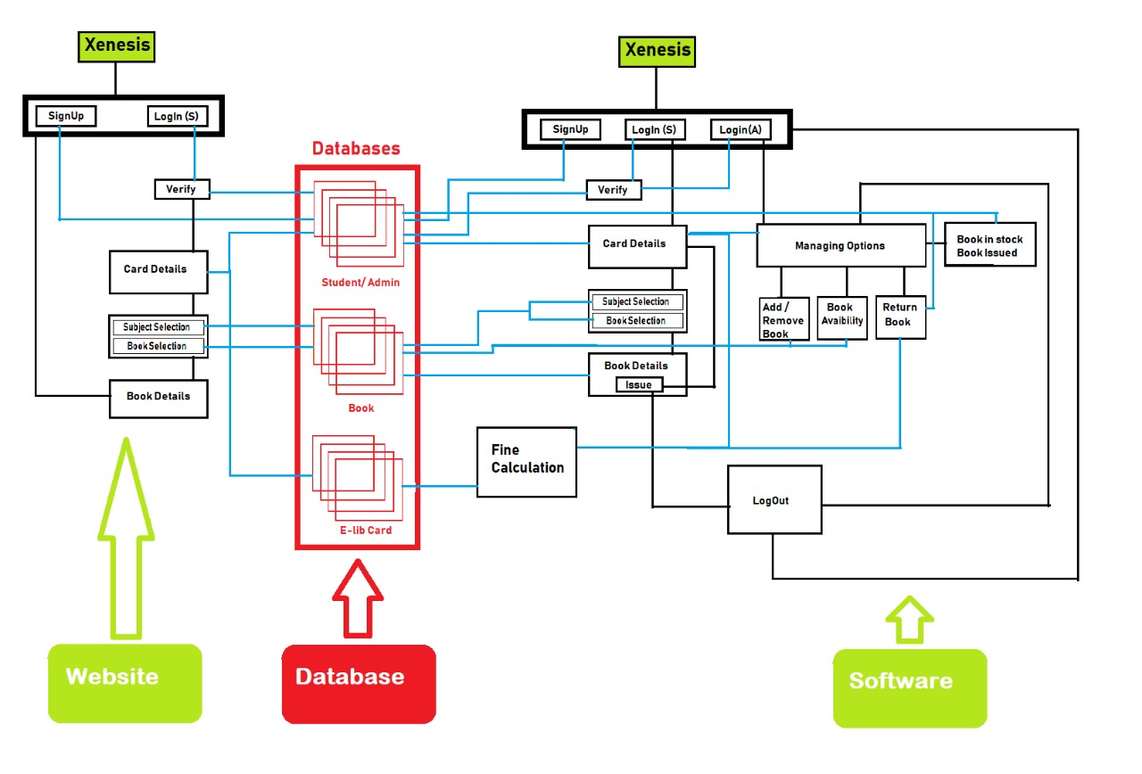
Flow chart of our program

Slide 15
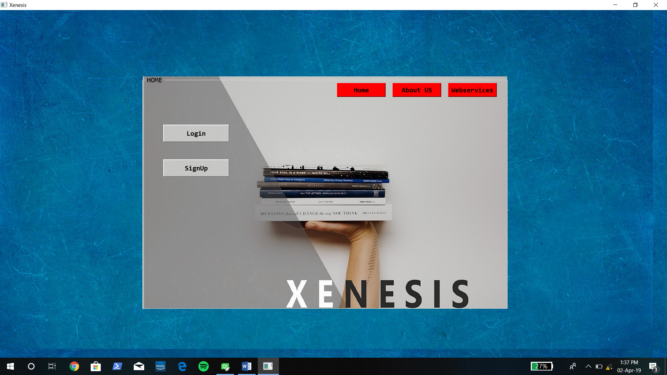
Home page
This is the home page of our
project.
By clicking on signup button the
user can make his/her account.
The members can do a direct
login.

Slide 16
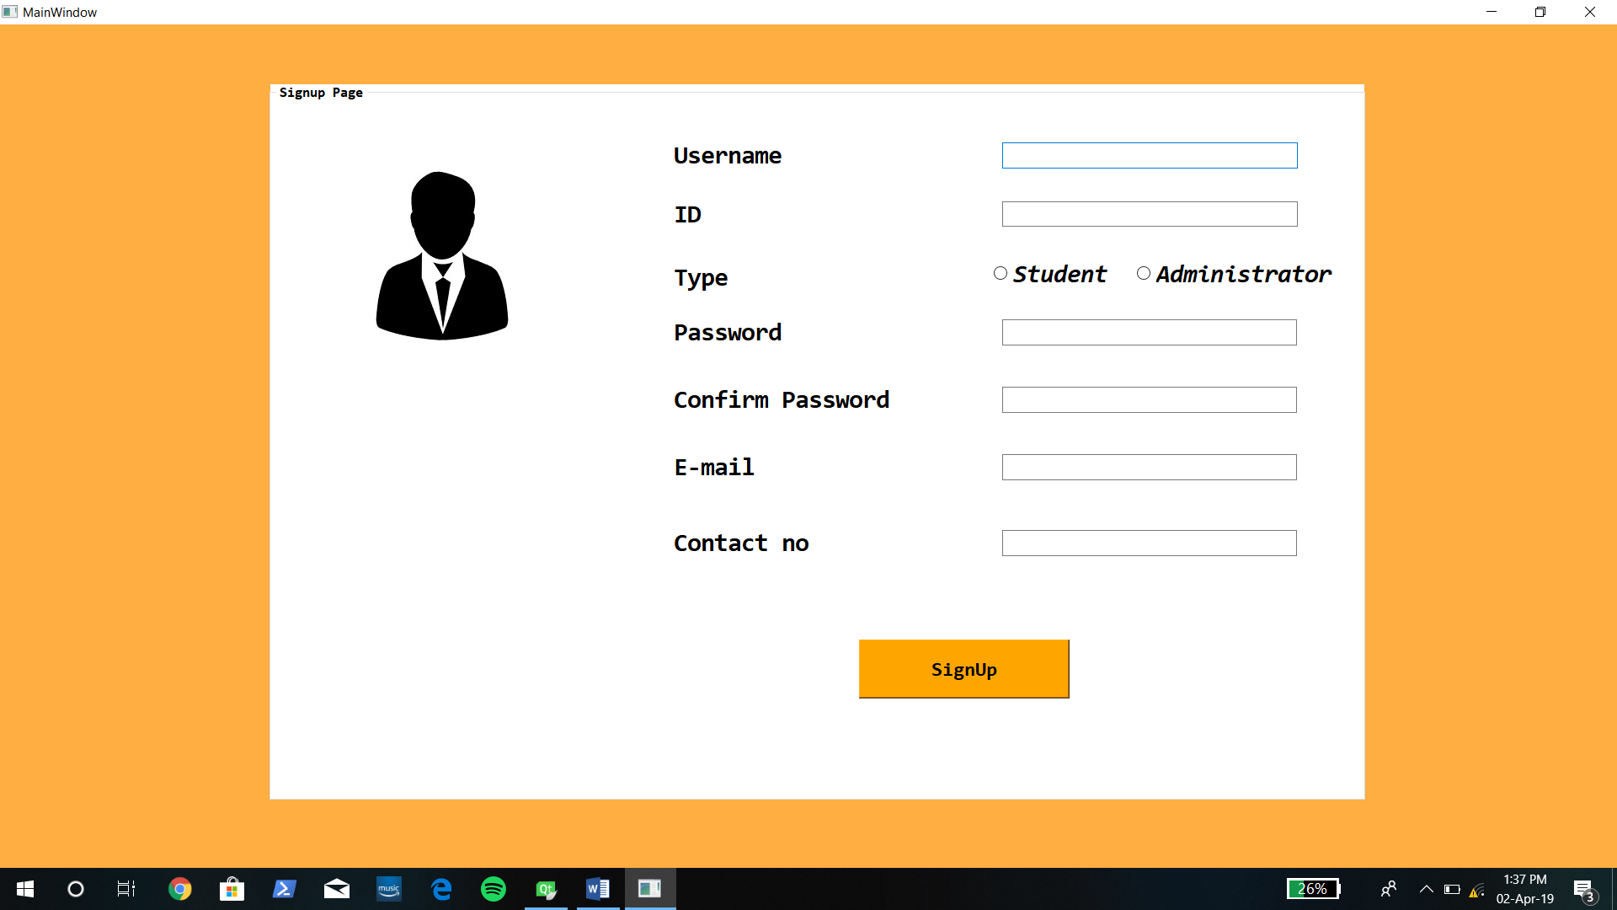
Signup page
This is the signup page where new
members can enter their details
and become a member of XLMS.
The details will be saved to our
database and can be accessed by
the Administrator.

Slide 17
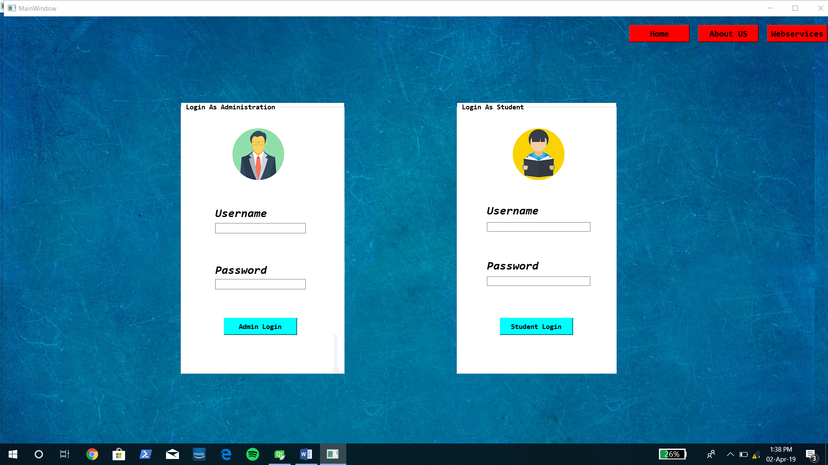
Login page
This is the login page where registered
user can access their privileges.
There are 2 fields to login
Admin login
Student login
By logging in the user can enjoy their
privileges.

Slide 18
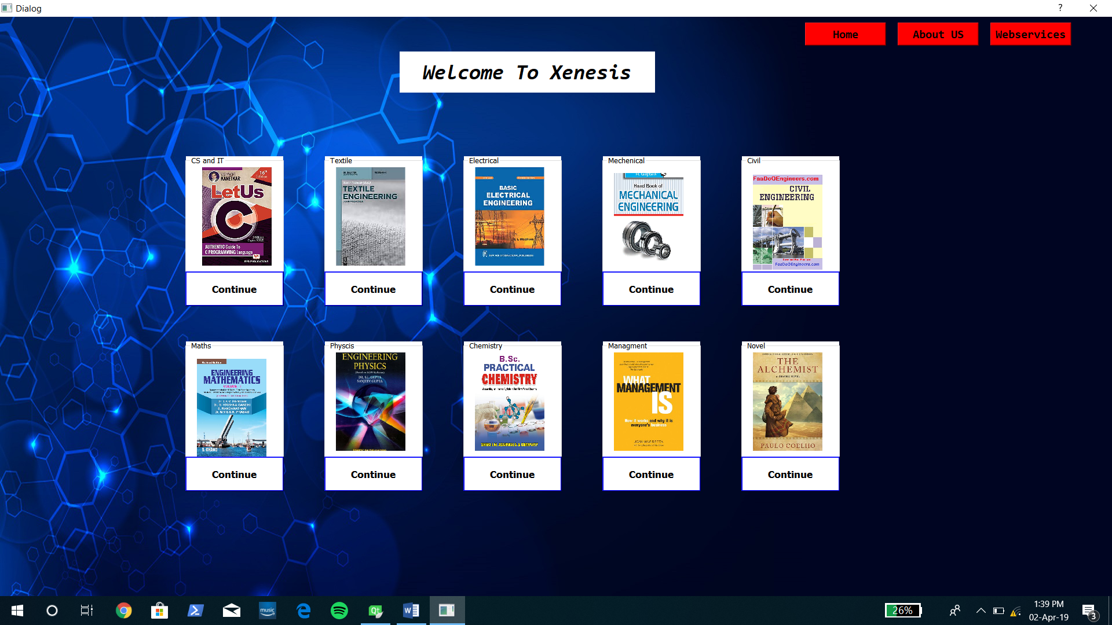
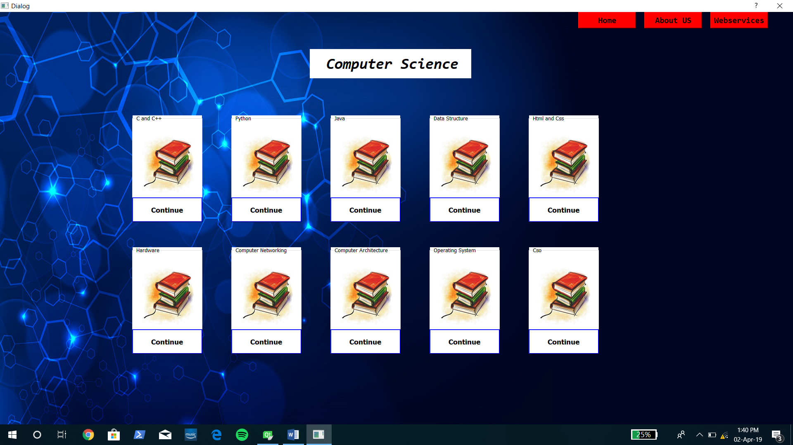
Subject selection page

Slide 19
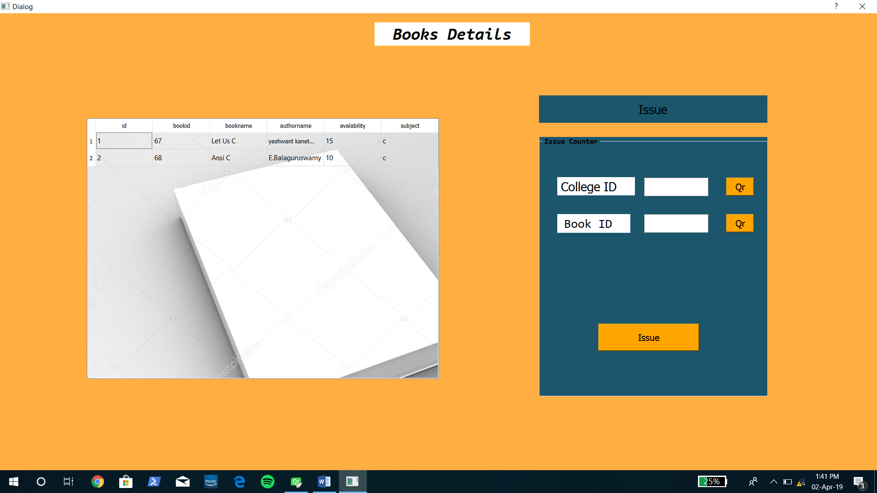
Book issuing system
This is our book issuing and book
availability page.

Slide 20
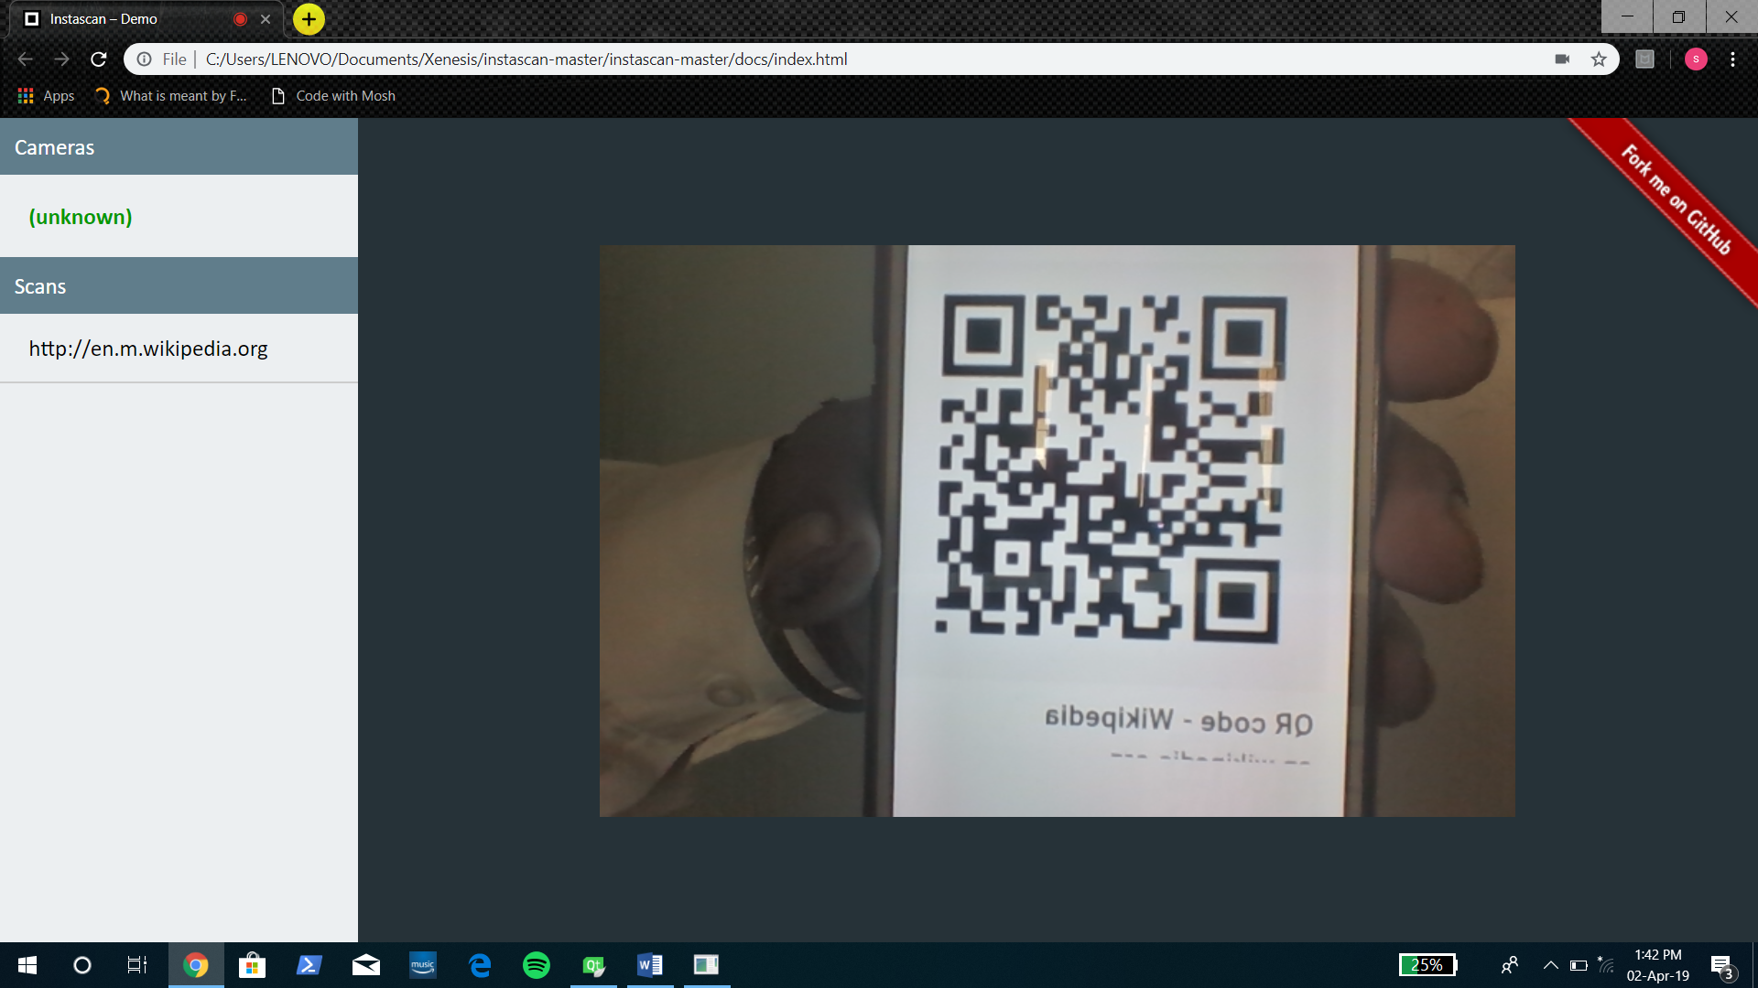
Qr code
This is the QR code scanner which will be
used to scan Book Id and thus will provide
fast working.
The scanned data will be saved in the
database.

Slide 21
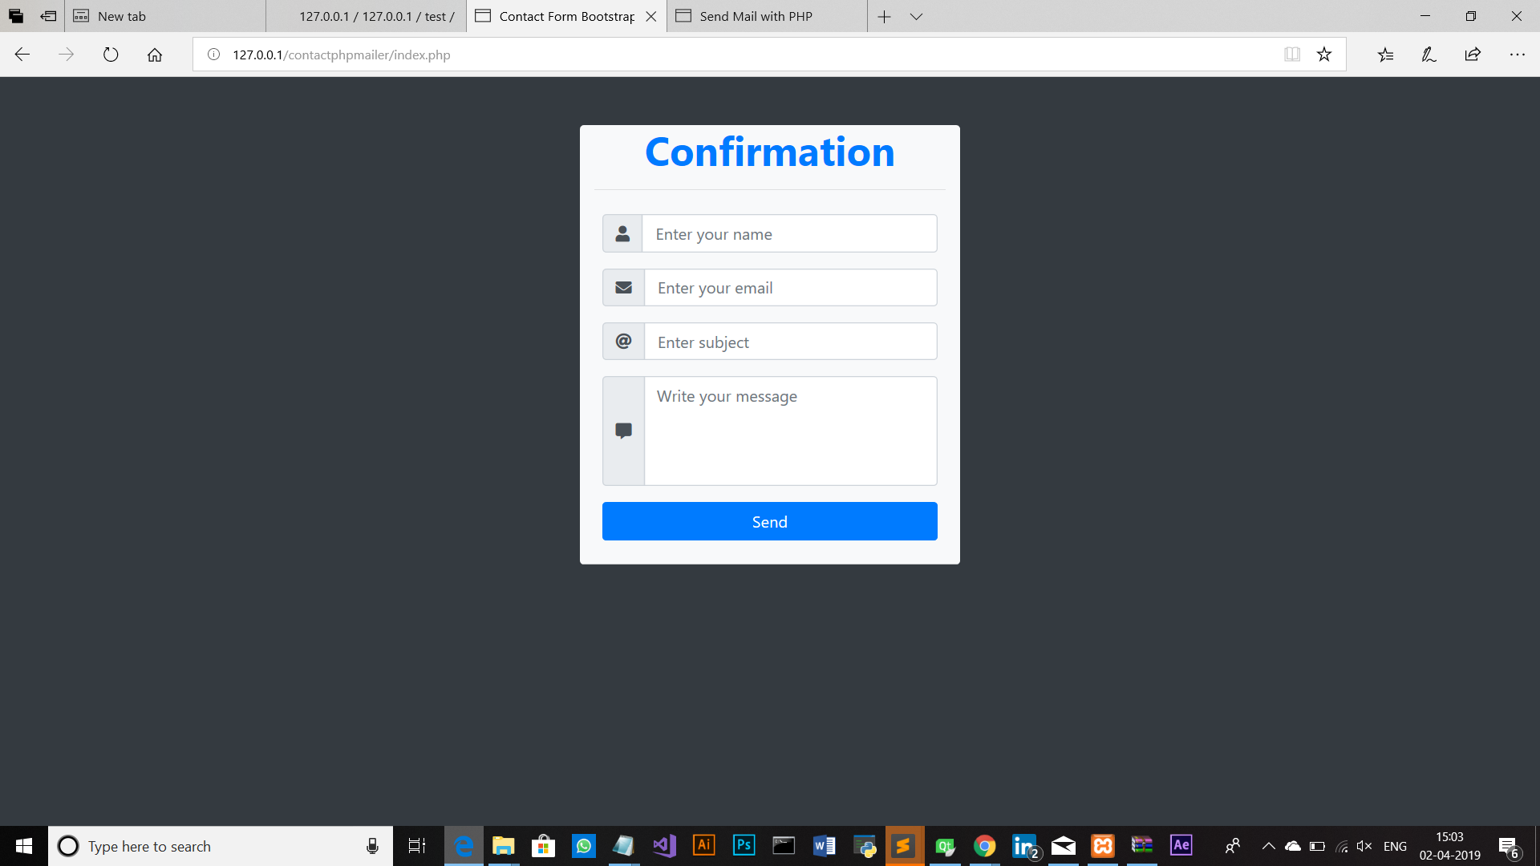
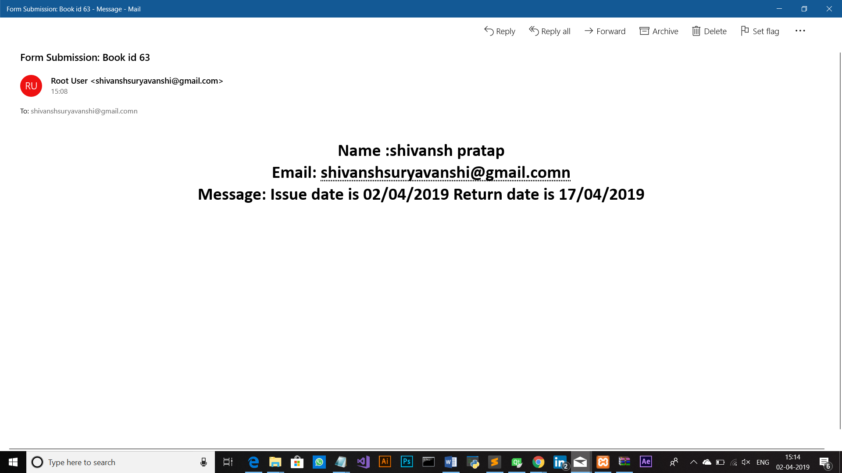
AUTOCONFIRMATION MAIL

Slide 22
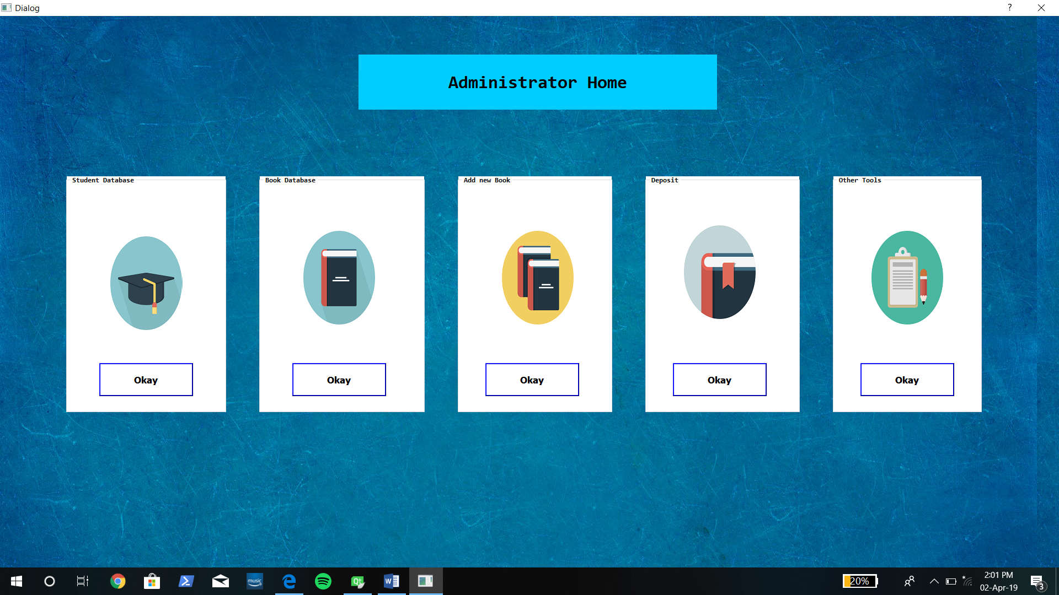
Administrator page
This is the administrator page where
the software has been given various
privileges.
Where he can view , edit, student
record.
The book record also can b edited .

Slide 23
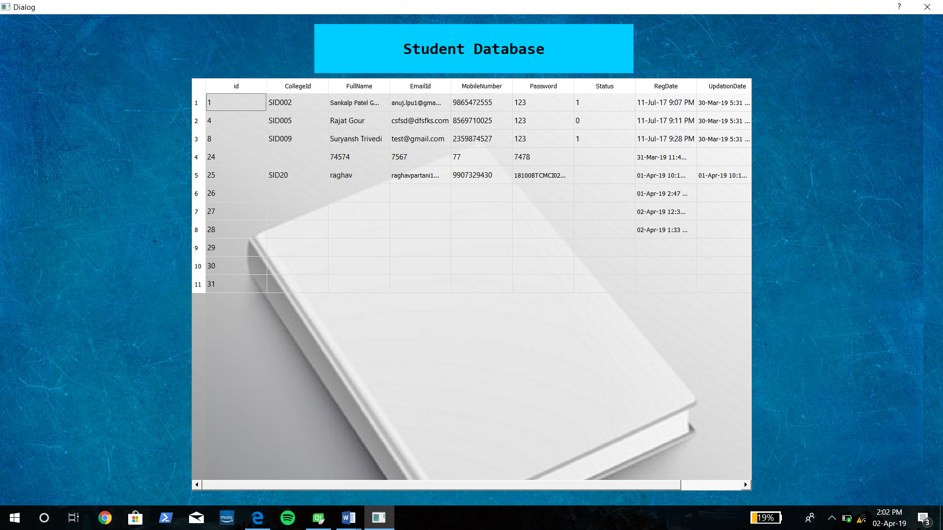
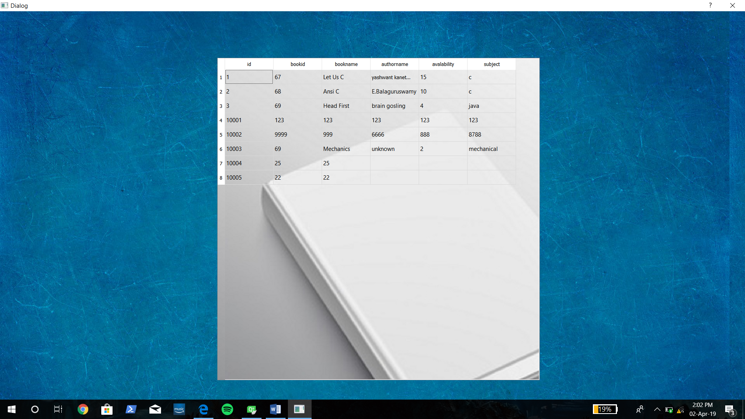
Student’s database and book database
This is the tables which will be displayed on our system which will be directly fetch from the
database.

Slide 24
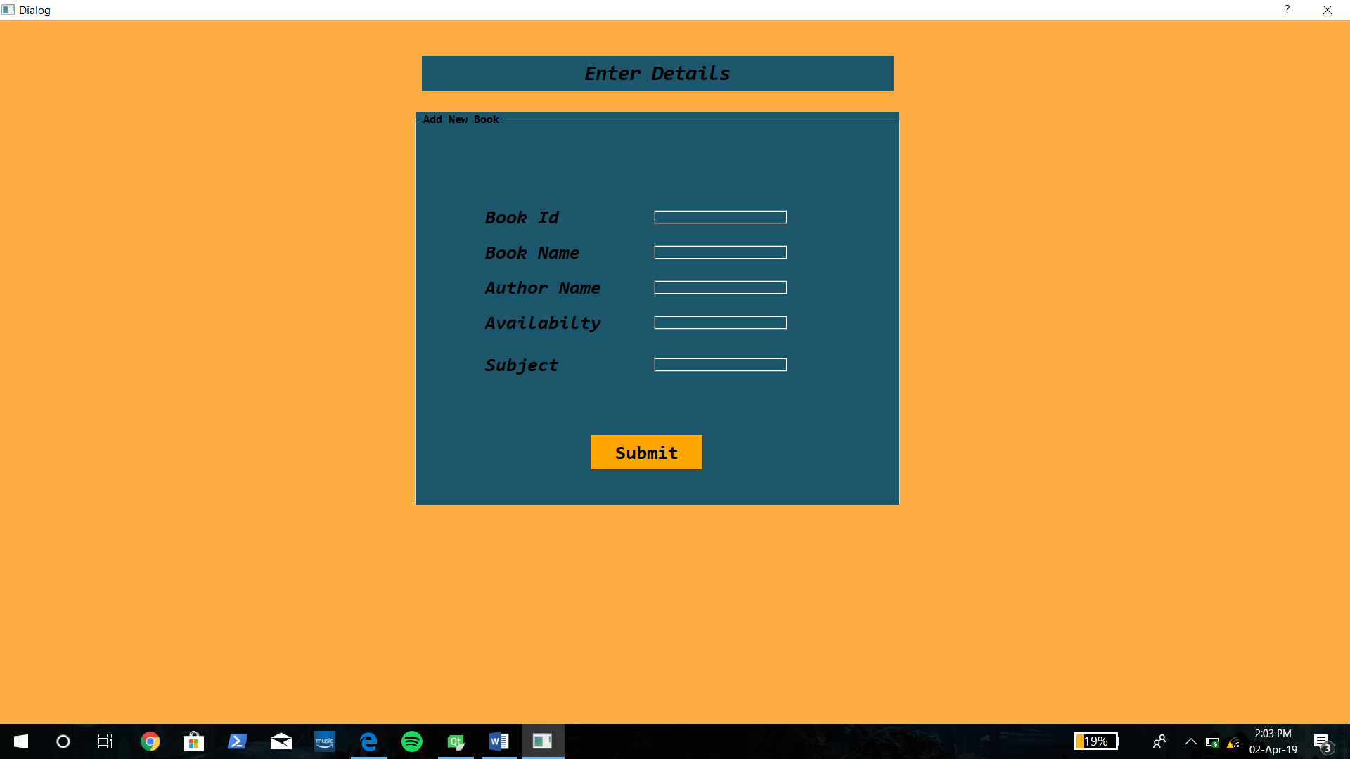
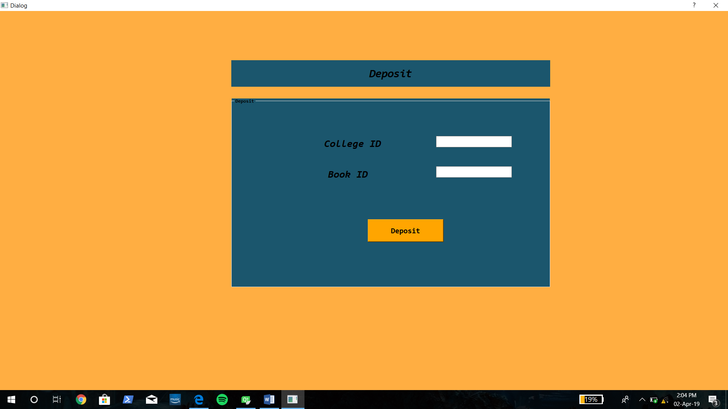
Add book and deposit book
This is our book search and book deposit page.

Slide 25
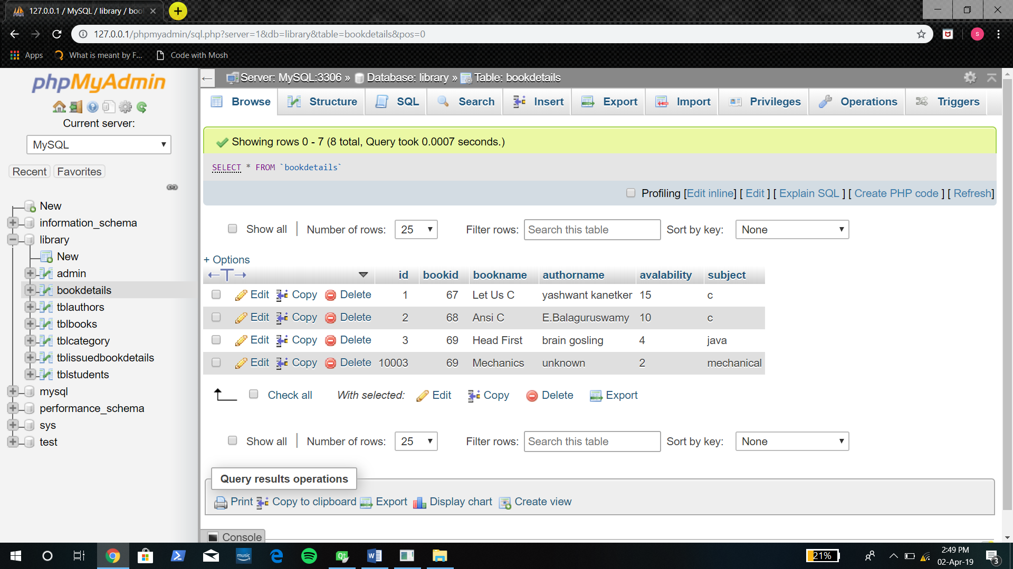
Project database
The project’s database is On
My sql and on php my admin.
The database has been setup on WAMP server.

Slide 26
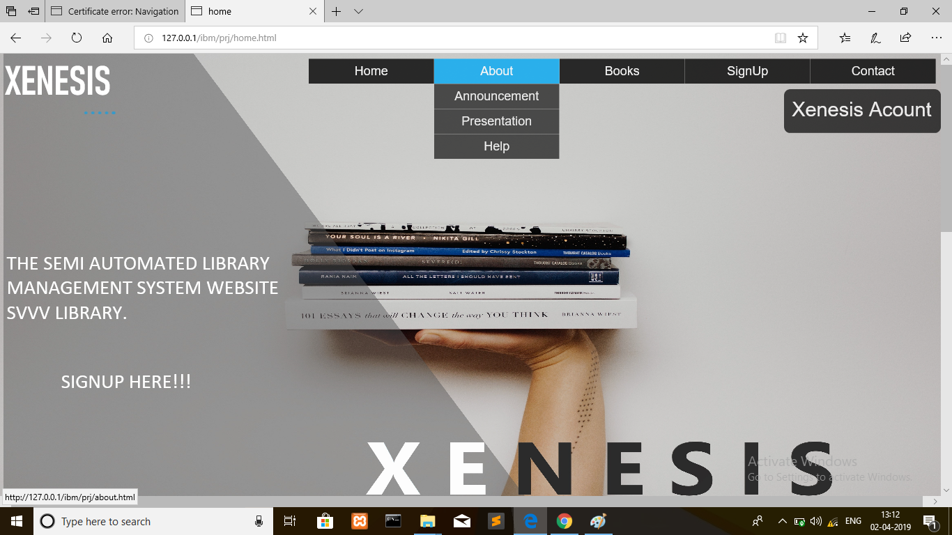
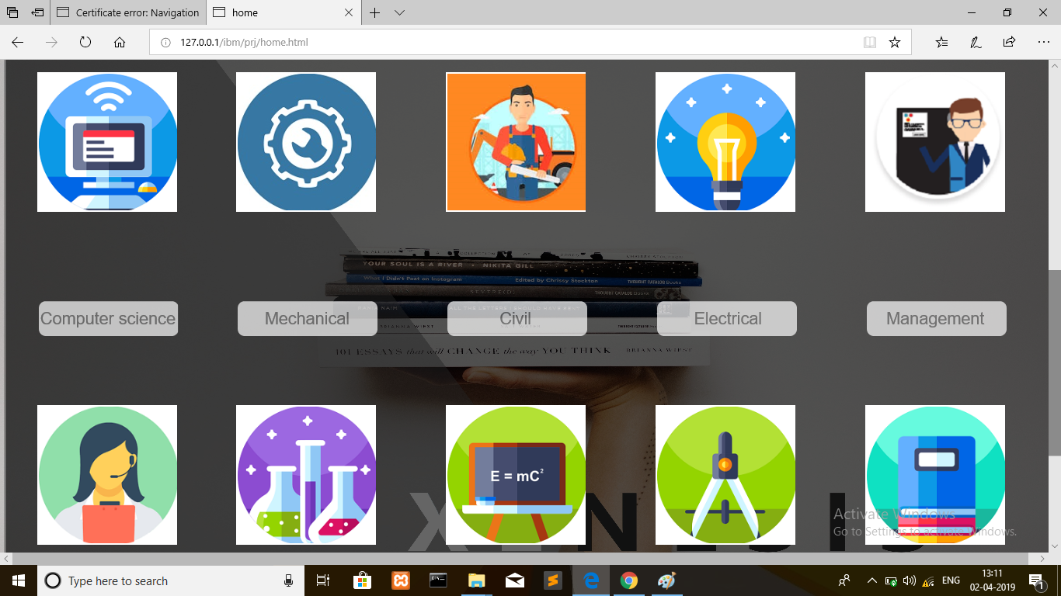
Xenesis web page
This our Xenesis library website in which student can access the library details online from any
Where.

Slide 27
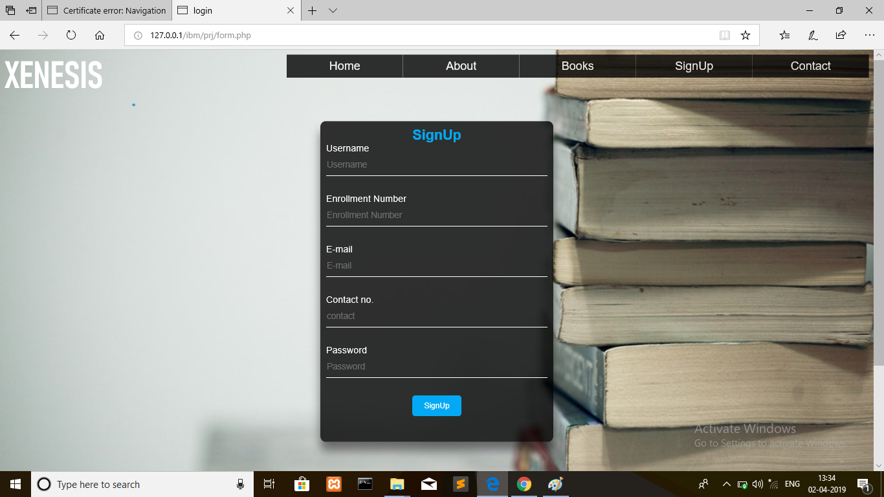
Website signup page

Slide 28
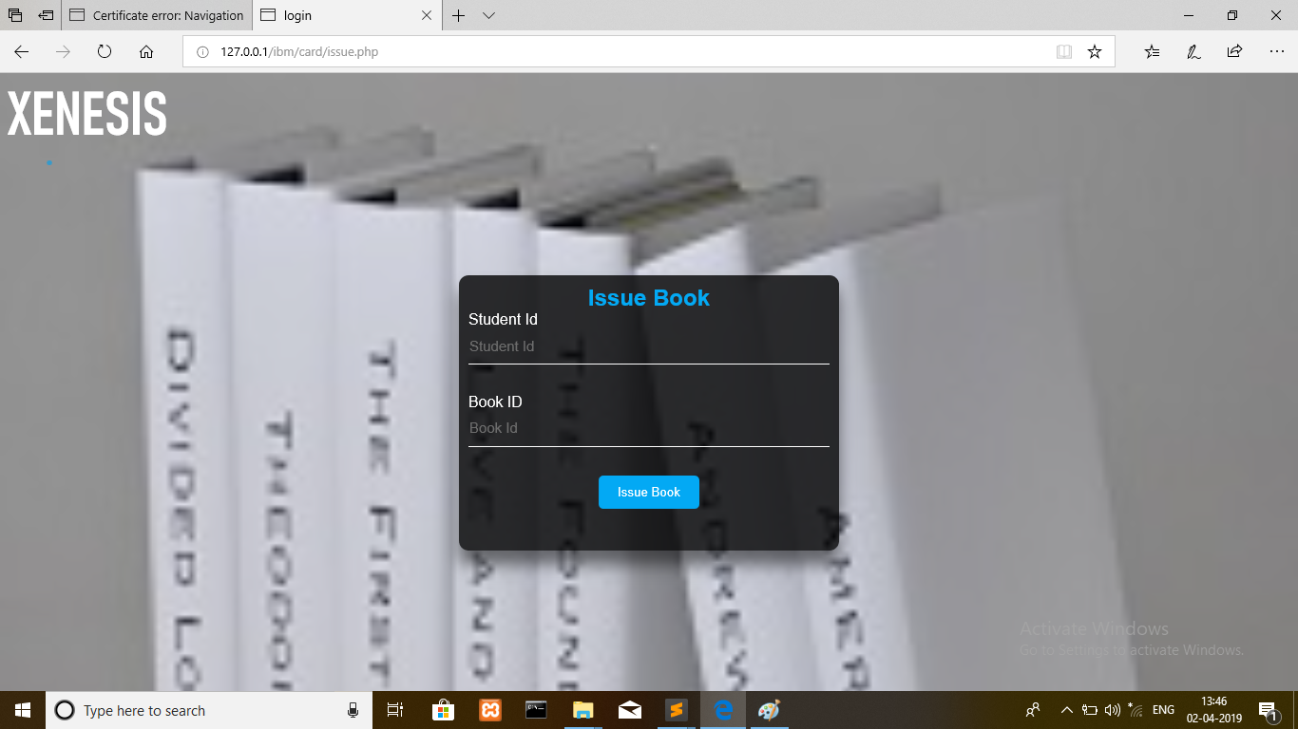
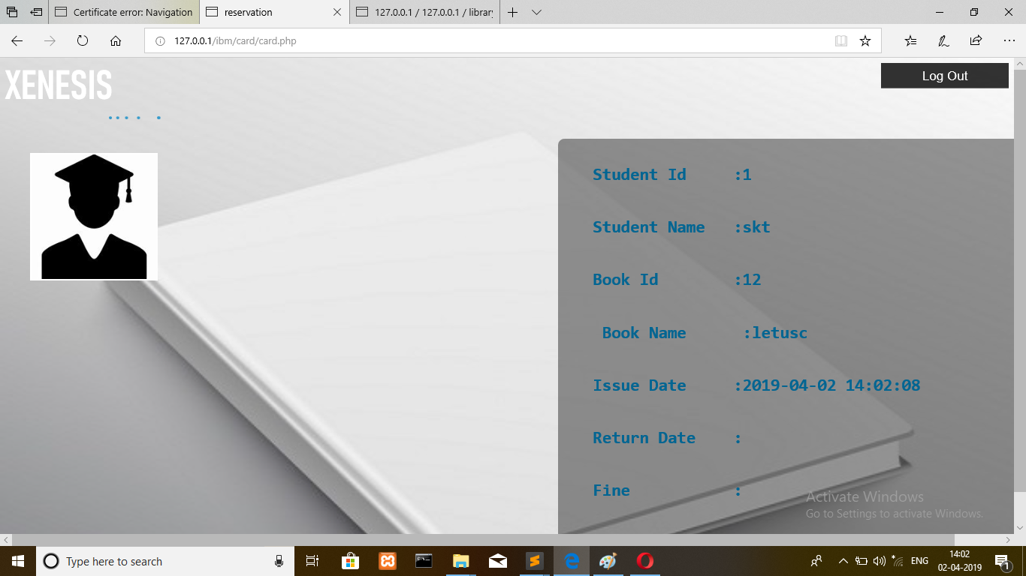
Online e-lib card detail

Slide 29
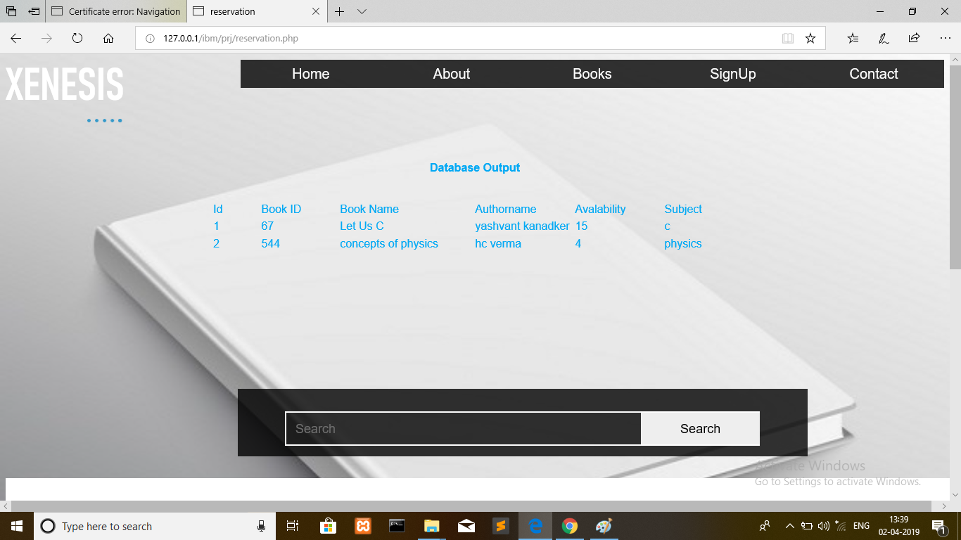
Book record on website

Slide 30
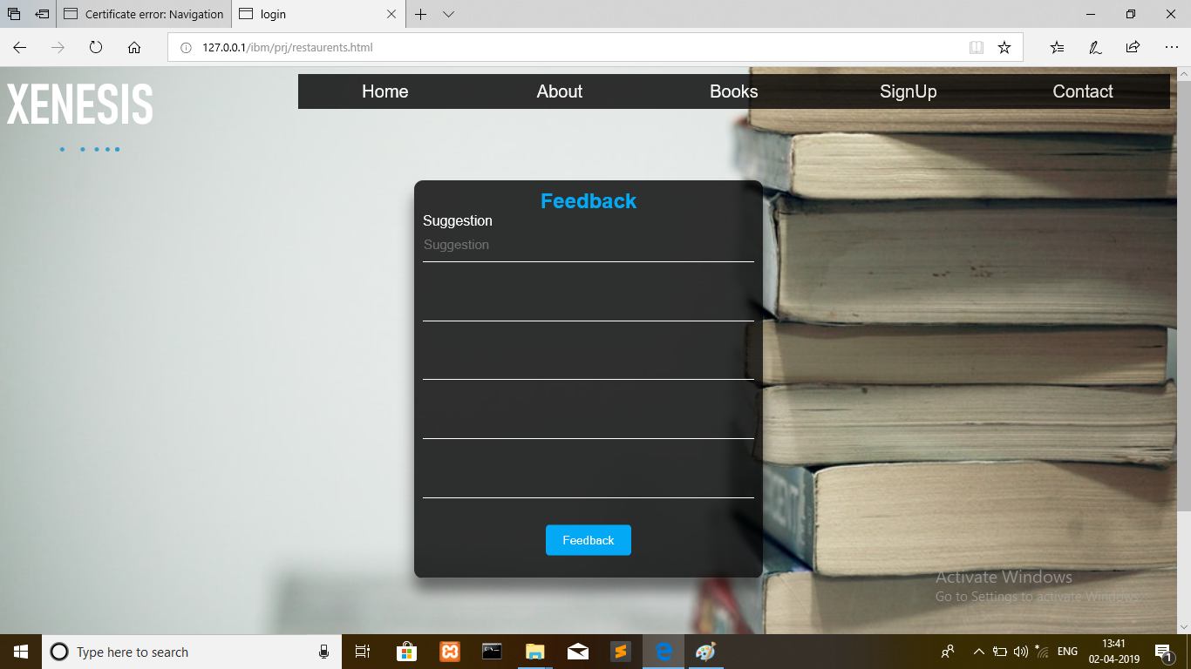
Student help / feedback

Slide 31
conclusion
The Xenesis library management system is for computerizing the working in a library.
The main strain we put in our project is to make the physical task less and make the library system Automated.
By using our system the efficiency of the library will be increased and a lot of time will be saved.
The software takes care of all the requirements of a library and is capable of providing information to both Students and Administrator about the books and login/signup details.
If the condition persists we can change the system working as per the need.

Slide 32
THANK YOU

